Slide 1

smart_home_systems
Alexandru Georgescu

Slide 2

Problem Statement
Homeowners face numerous challenges in managing temperature control, security, and lighting in their homes.
Inefficiencies of Traditional Systems: Traditional thermostat, doorbell, and lighting systems are often inefficient and inconvenient to manage.
We need a smart solution: There is a growing demand for a smart home system that integrates these components to provide automation.

Slide 3
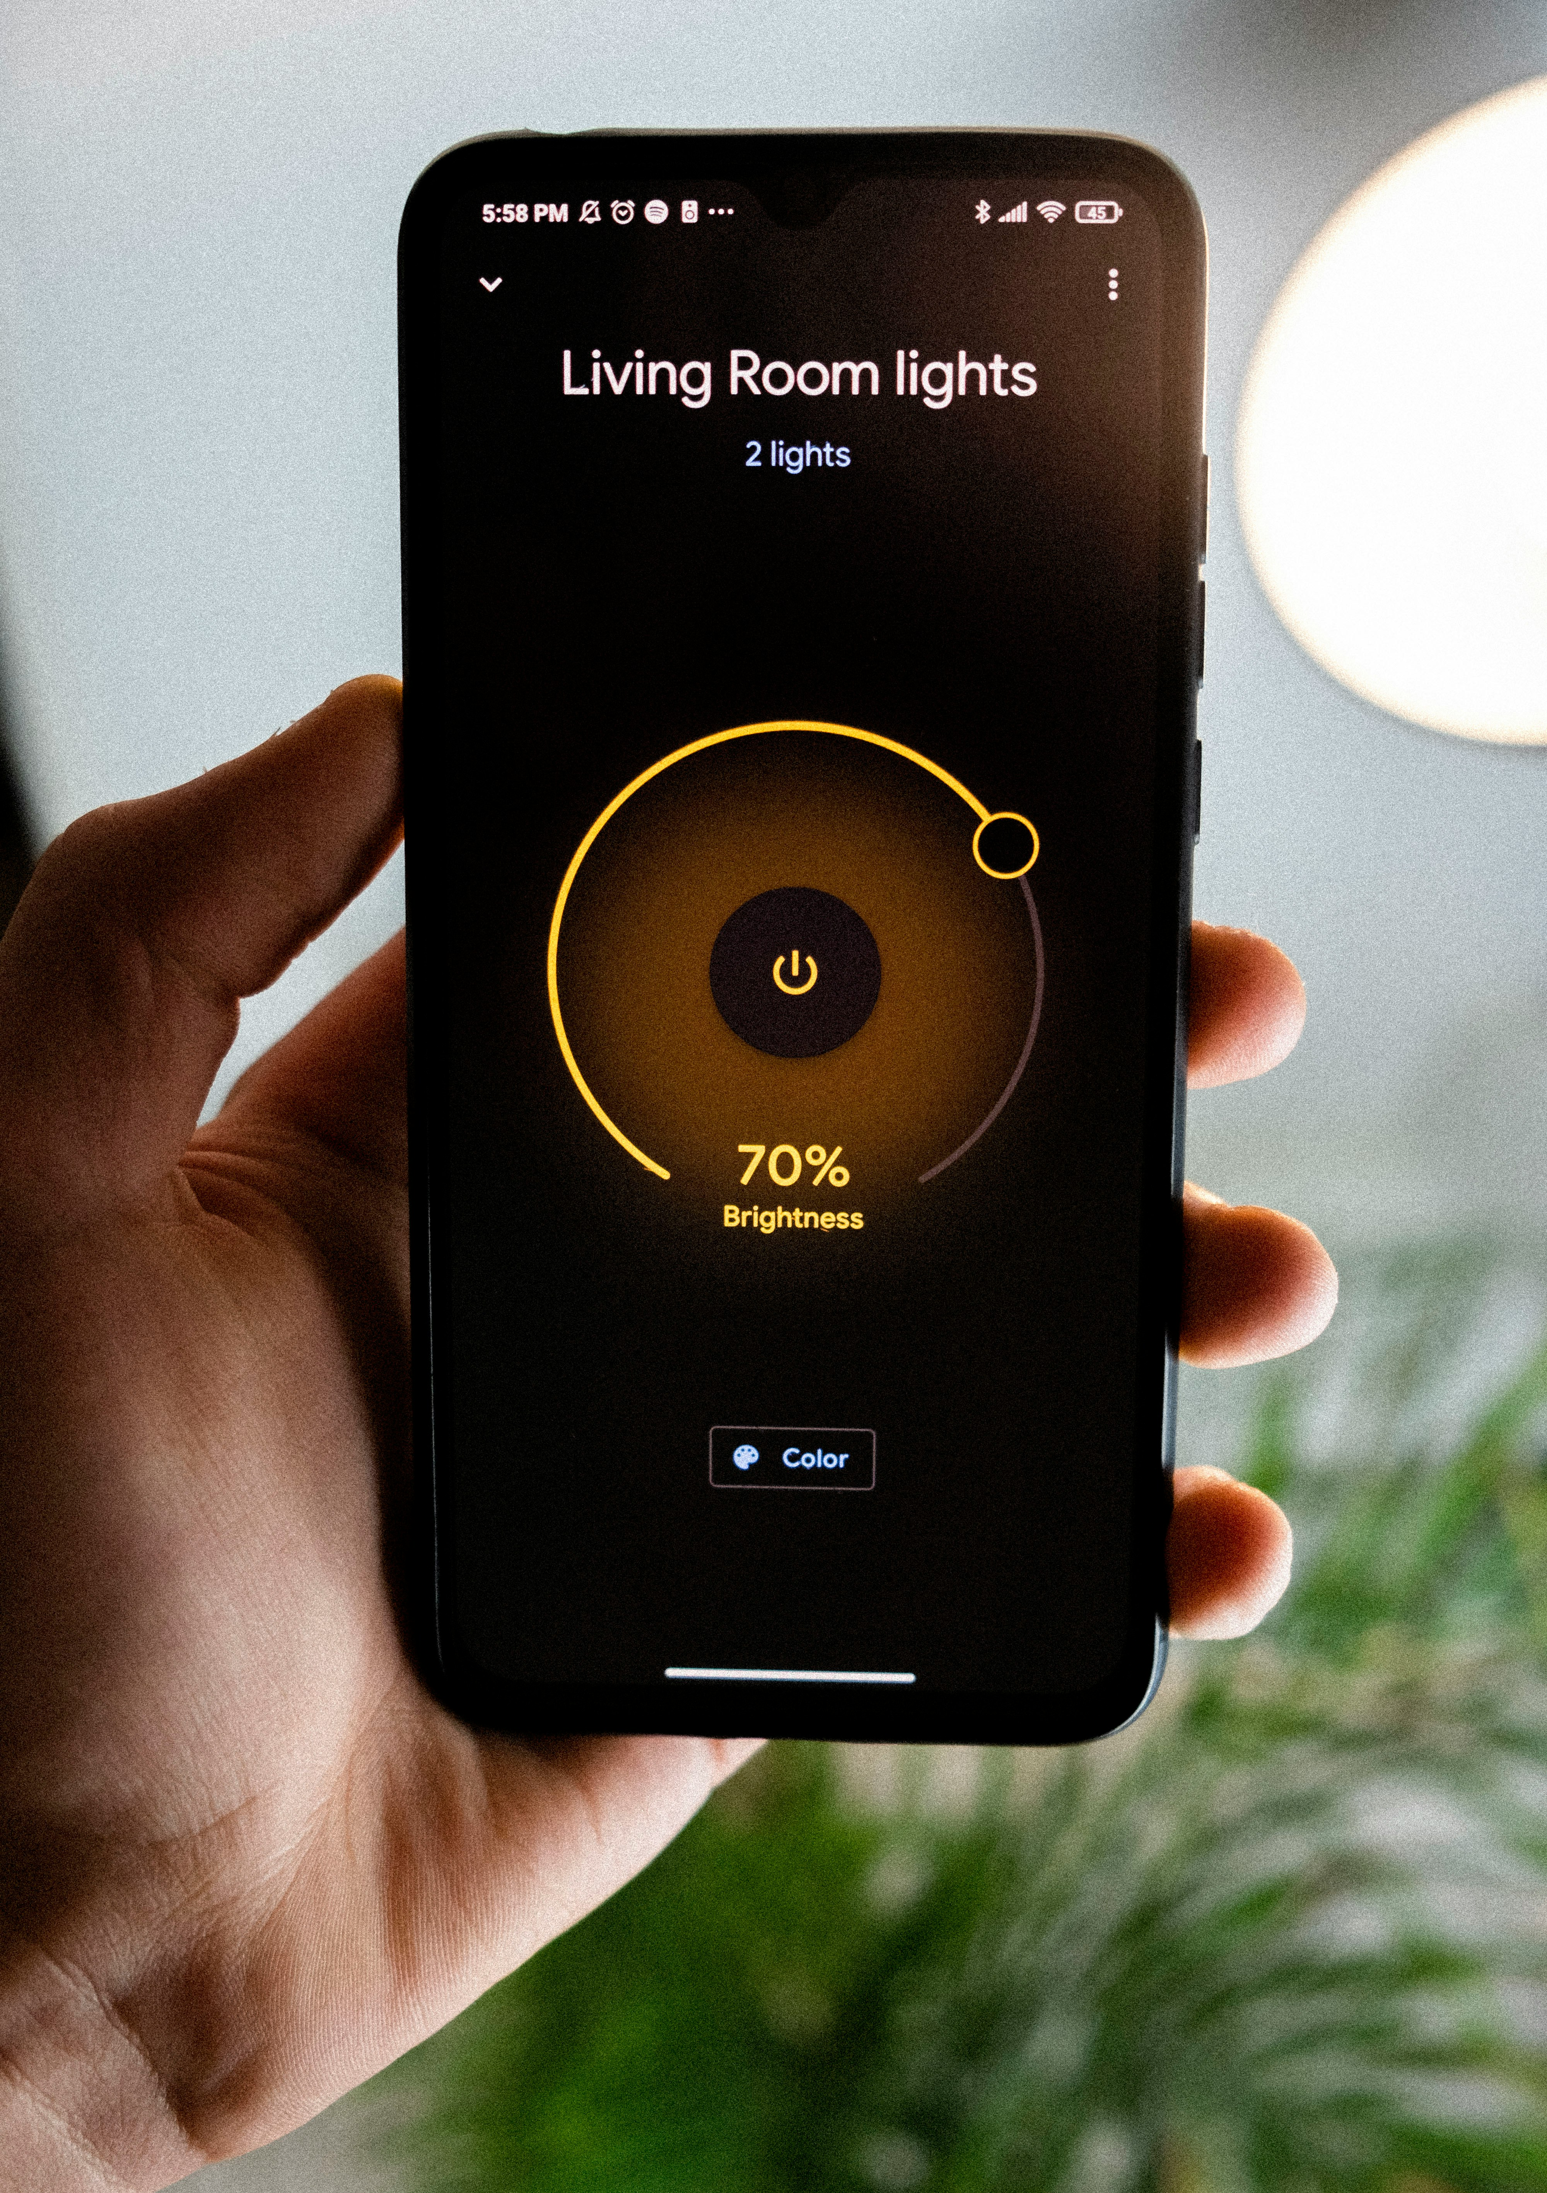
Smart Home
Our solution is a comprehensive Smart Home Management System designed to address the challenges faced by homeowners.
Integration of Smart Devices: Our system integrates smart thermostat, doorbell, and lighting functionalities to provide users with enhanced control and automation.
Key :
Remote access: Users can control and monitor their home environment remotely from anywhere.
Energy Efficiency: Smart algorithms optimize energy usage, leading to cost saving and environmental benefits.

Slide 4
Libraries
GRPC: Used for implementing the communication protocol between clients and services.
Chalk: Utilized for adding coloured text and styling to the command-line interface.
ProtoLoader: Used to load Protocol Buffer definitions and generate gRPC client and server code.
Inquirer: Implemented for creating interactive command-line prompts and user-input handling.

Slide 5
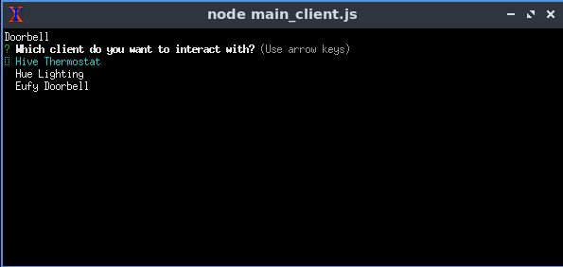
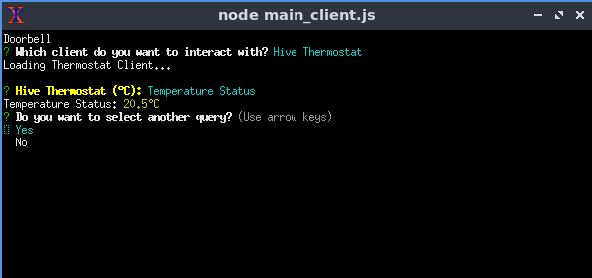
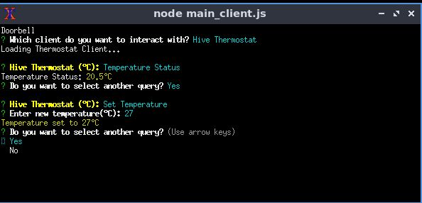
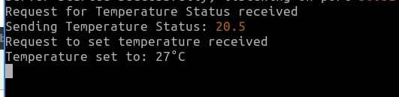
Output Thermostat

Slide 6
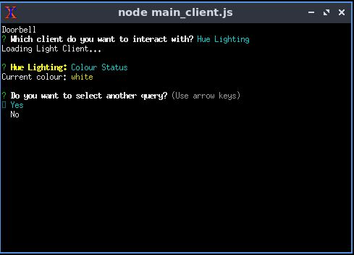
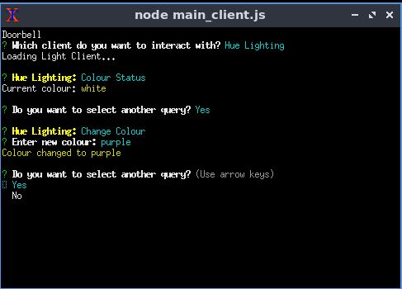
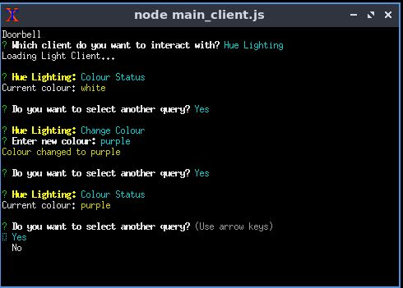
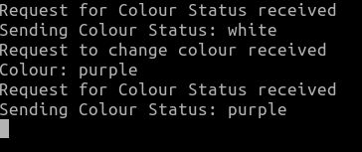
Output Lighting

Slide 7
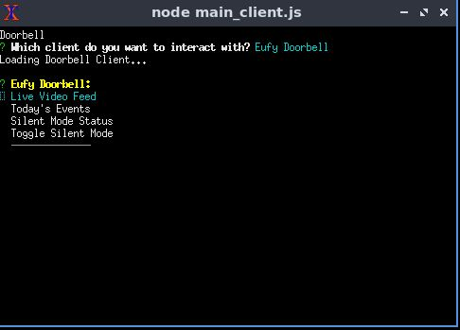
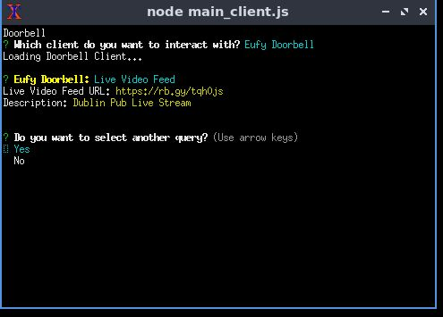
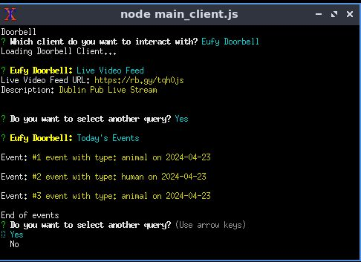
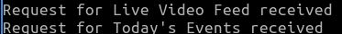
Output Thermostat

Slide 8
Thank you!

